Slide 1


First Meetup @ SF
Oct 5th, 2023
@ a16z San Francisco Office

Slide 2




About us
Woosuk Kwon
PhD Student, UC Berkeley
@woosuk_k
Zhuohan Li
PhD Student, UC Berkeley
@zhuohan123

Slide 3


Thanks our sponsors!
for venue & open-source AI grant
for catering & contributions to vLLM

Slide 4
vLLM Overview
Woosuk Kwon

Slide 5
Our Goal
Build the fastest and
easiest-to-use open-source
LLM inference & serving engine

Slide 6
PagedAttention
An attention algorithm that allows for storing continuous keys and values in non-contiguous memory space.

Slide 7
Manage KV cache like OS virtual memory
Physical KV blocks
Block Table
computer | scientist | and | mathe- matician
Artificial | Intelli- gence | is | the
renowned
future | of | tech- nology
Alan | Turing | is | a
Block Table
Request
A
Request
B
Logical KV blocks
Logical KV blocks
Alan | Turing | is | a
computer | scientist | and | mathematician
renowned
Artificial | Intelli- gence | is | the
future | of | tech- nology

Slide 8



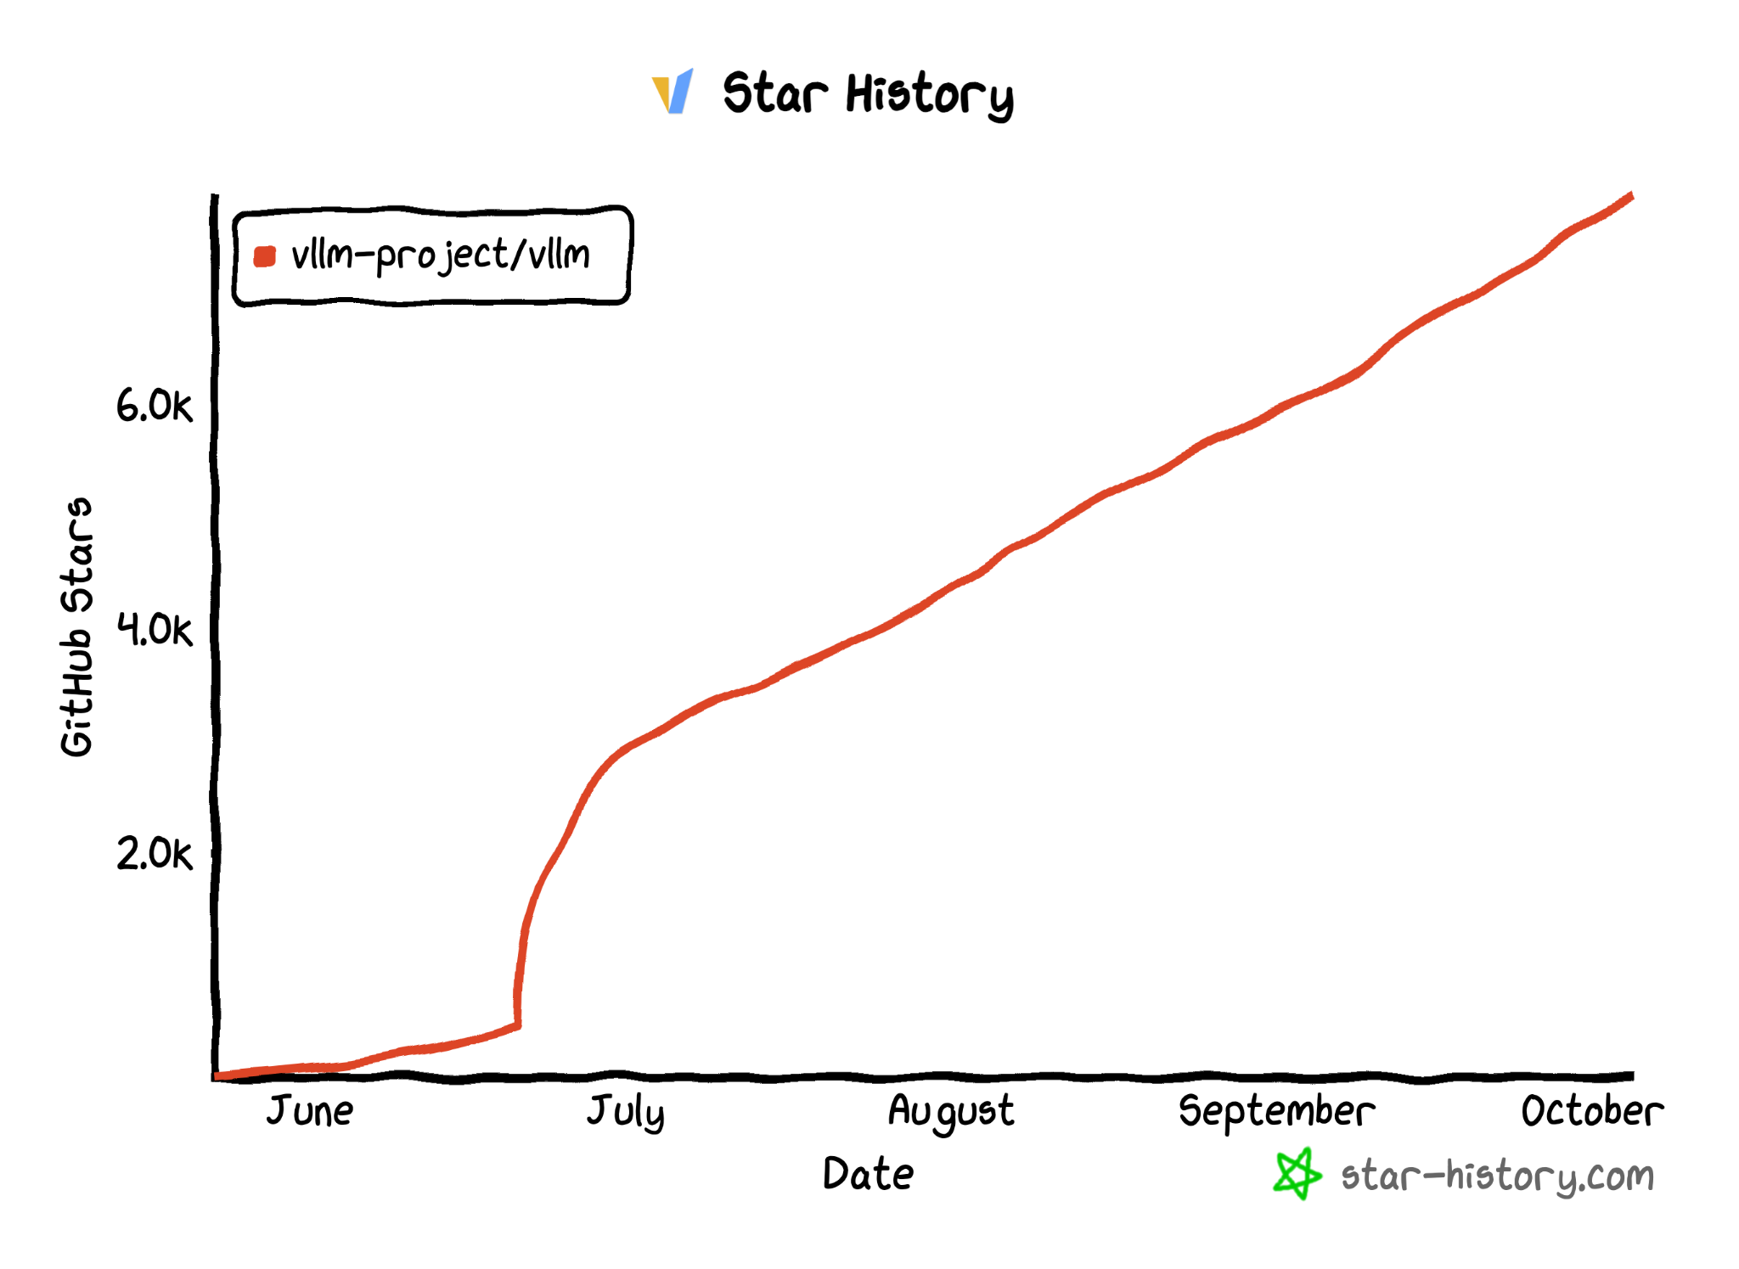
vLLM Github Repo
https://github.com/vllm-project/vllm
$ pip install vllm
7.9K Stars
Official
release!

Slide 9
vLLM API (1): LLM class
A Python interface for offline batched inference
from vllm import LLM
# Example prompts.
prompts = ["Hello, my name is", "The capital of France is"]
# Create an LLM with HF model name.
llm = LLM(model="meta-llama/Llama-2-7b-hf")
# Generate texts from the prompts.
outputs = llm.generate(prompts)

Slide 10
vLLM API (2): OpenAI-compatible server
A FastAPI-based server for online serving
Server
$ python -m vllm.entrypoints.openai.api_server --model meta-llama/Llama-2-7b-hf
Client
$ curl http://localhost:8000/v1/completions \
-H "Content-Type: application/json" \
-d '{
"model": "meta-llama/Llama-2-7b-hf",
"prompt": "San Francisco is a",
"max_tokens": 7,
"temperature": 0
}'

Slide 11

















vLLM Adopters
Open-Source Projects
Companies
lm-sys/FastChat
allenai/open-instruct
…
WizardLM
…

Slide 12
“Talk is cheap. Show me the code.”
 | https://github.com/lm-sys/FastChat/blob/main/fastchat/serve/vllm_worker.py |  | https://github.com/GoogleCloudPlatform/vertex-ai-samples/tree/main/community-content/vertex_vision_model_garden/model_oss/vllm
 | https://github.com/imoneoi/openchat/blob/master/ochat/evaluation/run_eval.py |  | https://github.com/leptonai/examples/tree/main/advanced/vllm
 | https://github.com/allenai/open-instruct/blob/main/eval/toxigen/run_eval.py |  | https://github.com/facebookresearch/llama-recipes/tree/main/examples/vllm
 | https://github.com/skypilot-org/skypilot/blob/master/llm/vllm/serve.yaml |  | https://github.com/triton-inference-server/tutorials/tree/main/Quick_Deploy/vLLM
 | https://github.com/nlpxucan/WizardLM/blob/main/WizardCoder/src/humaneval_gen_vllm.py |  | https://github.com/modal-labs/modal-examples/blob/main/06_gpu_and_ml/vllm_inference.py
 | https://github.com/ray-project/ray/blob/master/doc/source/serve/doc_code/vllm_example.py |  | https://github.com/replicate/vllm-with-loras
 | https://github.com/bentoml/OpenLLM/blob/main/openllm-python/src/openllm/models/auto/modeling_vllm_auto.py |  | https://github.com/scaleapi/llm-engine/tree/main/model-engine/model_engine_server/inference/vllm
lm-sys/FastChat
allenai/open-instruct
WizardLM
…
…

Slide 13
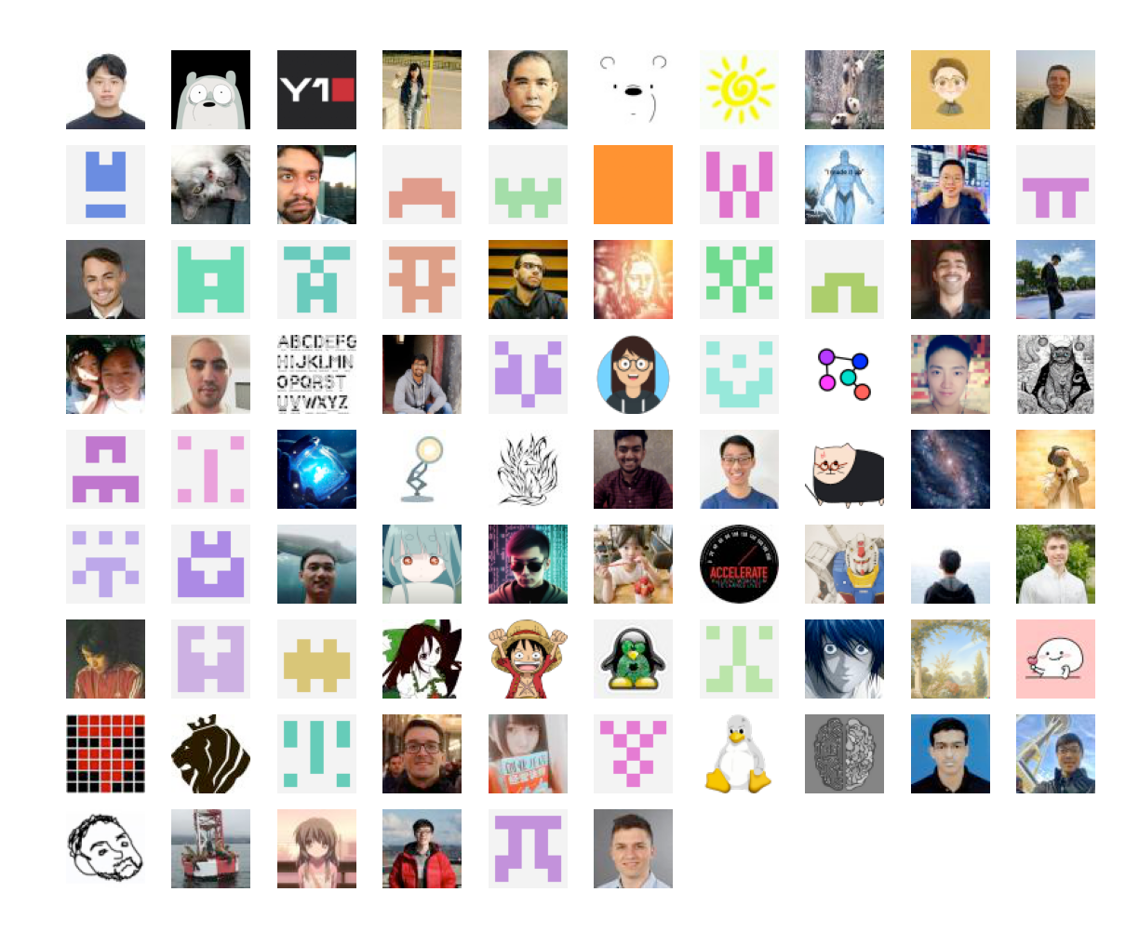
Contributors
Thanks to all the contributors who raised issues, participated in discussions, and submitted PRs!
…

Slide 14
vLLM System Walkthrough
Zhuohan Li

Slide 15

Goal of the walkthrough
Understand how vLLM processes a request and generates its outputs. Background for later content.
Learn where to modify if you would like to make a specific modification/contribution.

Slide 16
User Interface
End-user Interface vllm/entrypoints
Developer Interface vllm/engine
Synchronous
LLM
vllm/entrypoints/llm.py
LLMEngine
vllm/engine/llm_engine.py
Batched inference
def add_request()
def abort_request()
def step() → List[ReaquestOutput]
Stream one token output for a batch of requests
api_server
vllm/entrypoints/api_server.py
AsyncLLMEngine
vllm/engine/async_llm_engine.py
Simple demo API server
Asynchronous
openai_api_server
vllm/entrypoints/openai/api_server.py
async def generate()
async def abort()
+ background engine loop
OpenAI-compatible API server
User custom server

Slide 17
requests (prompts)
LLMEngine
vllm/engine/llm_engine.py
Centralized Controller
(same process as LLMEngine, CPU only)
Distributed Workers (distributed processes with GPUs)
Scheduler
vllm/core/scheduler.py
N ×
Worker
vllm/worker/worker.py
BlockSpaceManager
vllm/core/block_manager.py
CacheEngine
vllm/worker/cache_engine.py
Worker.model
vllm/model_executor/models
BlockAllocator (GPU/CPU)
vllm/core/block_manager.py
PagedAttention
vllm/model_executor/layers/ attention.py
…

Slide 18


Before serving requests 1. Initialize & load model
LLMEngine
vllm/engine/llm_engine.py
Worker
vllm/worker/worker.py
× N
Worker.model
vllm/model_executor/models
model.load_weights
vllm/model_executor/models
Initialize & load from HuggingFace Model Hub

Slide 19

Before serving requests 2. Profile memory usage
LLMEngine
vllm/engine/llm_engine.py
Worker
vllm/worker/worker.py
× N
Worker.profile_num_available_blocks
vllm/model_executor/models
Worker.model
vllm/model_executor/models
Profile the memory usage with a batch with the max possible #tokens.
#GPU KV blocks = remaining memory / block byte size

Slide 20


Before serving requests 3. Pre-allocate KV Blocks
LLMEngine
vllm/engine/llm_engine.py
Scheduler
vllm/core/scheduler.py
Worker
vllm/worker/worker.py
× N
#GPU KV blocks
BlockSpaceManager
vllm/core/block_manager.py
CacheEngine
vllm/worker/cache_engine.py
#GPU KV blocks
BlockAllocator (GPU/CPU)
vllm/core/block_manager.py
Allocate KV cache memory
Initialize block table

Slide 21


When requests arrive
Request prompt: “The future of Artificial Intelligence”
LLMEngine
vllm/engine/llm_engine.py
1. Tokenization: [1, 450, 5434, 310, 3012, 928, 616, 3159, 28286]
2. Add to the scheduler’s waiting queue
Scheduler
vllm/core/scheduler.py
Waiting request queue
Running request queue
Swapped request queue

Slide 22

At every step, the scheduler
Decide the set of requests to run at the current step.
When there are free KV block memory waiting → running
When no KV block memory available for new tokens: Swapping: running → swapped Recomputation: running → waiting
Scheduler
vllm/core/scheduler.py
BlockSpaceManager
vllm/core/block_manager.py
Allocate space for new KV Cache.
Handle block sharing.
Swap/delete preempted KV blocks.
→ Cache instructions & Block table
BlockAllocator (GPU/CPU)
vllm/core/block_manager.py

Slide 23
At every step, the worker
N ×
Worker
vllm/worker/worker.py
Cache instructions
CacheEngine
vllm/worker/cache_engine.py
Swap blocks between GPU & CPU.
Perform copy-on-write for shared blocks.
Token IDs & Block Table
Worker.model
vllm/model_executor/models
Execute the model with tensor parallelism

Slide 24

At every step, the model
Token IDs & Block Table
Worker.model
vllm/model_executor/models
A PyTorch model (tensor model parallel shard)
xformers/FlashAttention for prompt
PagedAttention kernel for generation
PagedAttention
vllm/model_executor/layers/attention.py
ParallelLinear
vllm/parallel_utils/layers.py
Optimized kernels for other layers & distributed execution
QuantizedLinear
vllm/model_executor/layers/quantized_linear/
Faster kernels (e.g. LayerNorm)
vllm/model_executor/layers/…
Sampler
vllm/model_executor/layers/attention.py
Greedy/Random/Beam search → Generated tokens

Slide 25


streaming results
requests (prompts)
LLMEngine
vllm/engine/llm_engine.py
detokenize
1 new token ID for each request
Centralized Controller
(same process as LLMEngine, CPU only)
Distributed Workers (distributed processes with GPUs)
Scheduler
vllm/core/scheduler.py
unfinished requests
Worker
vllm/worker/worker.py
N ×
BlockSpaceManager
vllm/core/block_manager.py
CacheEngine
vllm/worker/cache_engine.py
Worker.model
vllm/model_executor/models
BlockAllocator (GPU/CPU)
vllm/core/block_manager.py
PagedAttention
vllm/model_executor/layers/ attention.py
…

Slide 26
Summary
Core component: LLMEngine
Centralized controller → Distributed workers
Scheduler prepares the requests at each step
Workers run the model with PagedAttention

Slide 27
vLLM Recent Updates
Woosuk Kwon

Slide 28
Our journey since the project release
1. Supporting new models
2. Optimizing performance
3. Ensuring correctness & robustness
4. Improving usability
5. Code gardening & refactoring

Slide 29
Our journey since the project release
1. Supporting new models
2. Optimizing performance
3. Ensuring correctness & robustness
4. Improving usability
5. Code gardening & refactoring

Slide 30




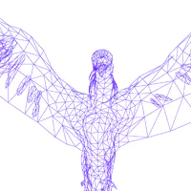




Supported models
Contributed by MistralAI
Supported from Day 1
LLaMA/Vicuna/ LLaMA-2/CodeLlama
Mistral
GPT-J/NeoX
+ 4 more architectures
+ RoPE scaling
OPT
GPT
Falcon
+ Quantization
BLOOM
StarCoder
MPT

Slide 31
Our journey since the project release
1. Supporting new models
2. Optimizing performance
3. Ensuring correctness & robustness
4. Improving usability
5. Code gardening & refactoring

Slide 32
Optimization (1): Efficient de-tokenization
Token IDs
1 | 450 | 5434 | 310 | 319 | 29902 | 338 | 5921
Tokens
<s> | The | future | of | A | I | is | promise
Text
“The future of AI is promise”

Slide 33
Optimization (1): Efficient de-tokenization
Reduces CPU overhead by caching and incremental updates
Token IDs
1 | 450 | 5434 | 310 | 319 | 29902 | 338 | 5921
Tokens
<s> | The | future | of | A | I | is
promise
Cached
Text
“The future of AI is promise”
Cached

Slide 34
Optimization (1): Efficient de-tokenization
Reduces CPU overhead by caching and incremental updates
New ID
Token IDs
1 | 450 | 5434 | 310 | 319 | 29902 | 338 | 5921
292
<s> | The | future | of | A | I | is
promise
Tokens
-ing
Text
“The future of AI is promising”

Slide 35
Optimization (2): Vectorized sampler
Iterative (Previous)
Vectorized (Current)
Sequence 1
logits
Output
All sequences
0.1 | -0.2 | 0.03 | 0.13 | -0.1
logits
torch.multinomial()
torch.topk()
next_token_ids: 3
log_probs: ...
SamplingParams
0.1 | -0.2 | 0.03 | 0.13 | -0.1
n: 1
log_probs: 3
-0.3 | 0.71 | 0.11 | -0.2 | 0.58
torch.multinomial()
torch.topk()
Outputs
log_probs: ...
next_token_ids: 1,4
log_probs: ...
SamplingParams
next_token_ids: 3
log_probs: ...
Sequence 2
log_probs: 5
logits
n: 2
log_probs: 5
Output
n: 1
log_probs: 3
-0.3 | 0.71 | 0.11 | -0.2 | 0.58
torch.multinomial()
torch.topk()
next_token_ids: 1,4
log_probs: ...
SamplingParams
n: 2
log_probs: 5
...

Slide 36
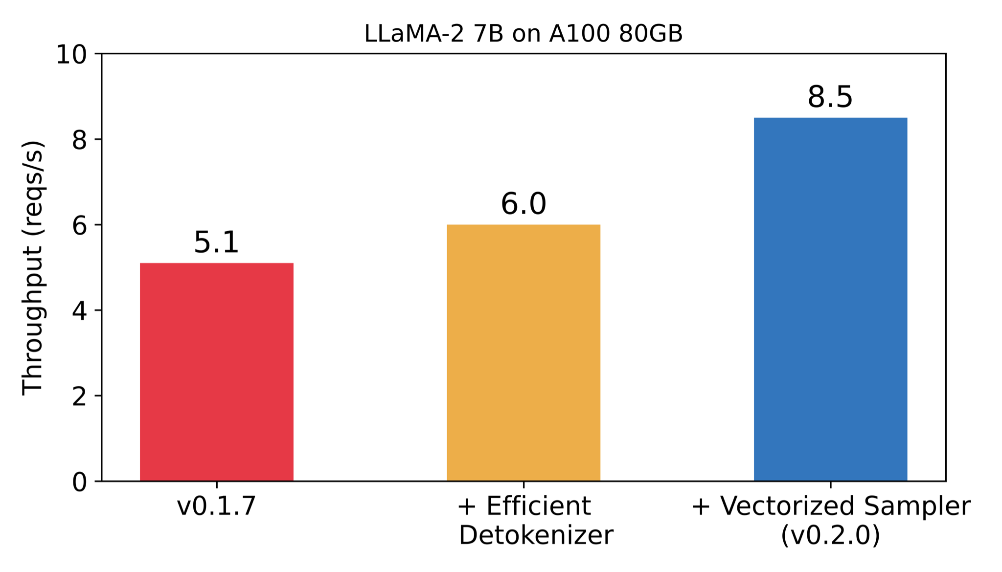
Performance improvements
v0.2.0: Up to 66% throughput increase compared to v0.1.7
42%↑
18%↑

Slide 37
Our journey since the project release
1. Supporting new models
2. Optimizing performance
3. Ensuring correctness & robustness
4. Improving usability
5. Code gardening & refactoring

Slide 38
Ensuring correctness is hard
Because of the custom CUDA kernels, vLLM cannot always ensure bit-wise correctness
Ref. logits:
-0.88 | 0.10 | … | 0.13 | -0.06
vLLM logits:
-0.85 | 0.10 | … | 0.17 | -0.09
As a result, vLLM can sometimes generate different output compared to reference implementations
Ref. output:
“The future of AI is unpredictable but full of potential.”
vLLM output:
“The future of AI is promising and transformative.”

Slide 39
Tests for ensuring correctness
1. Unit tests for op-level correctness
2. End-to-end tests for certain cases
Ex) argmax sampling, beam search
3. Accuracy tests on standard benchmarks

Slide 40
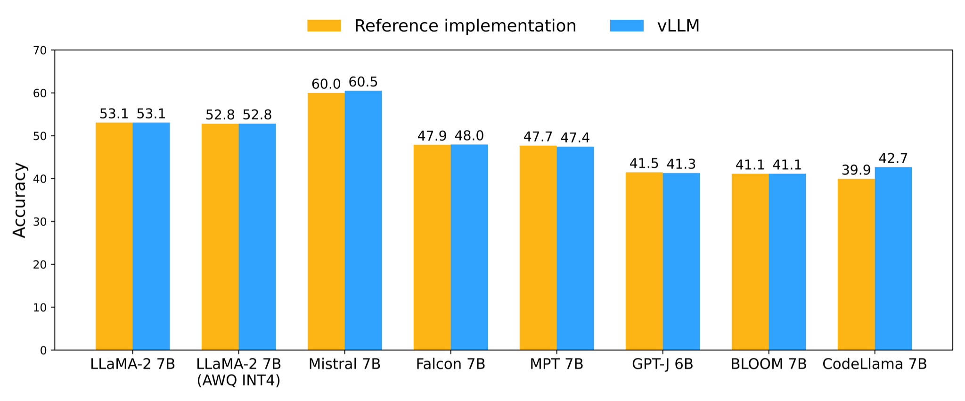
Accuracy tests
Benchmark: AI2 Reasoning Challenge (ARC)*
* acc_norm with 25 shots, https://github.com/EleutherAI/lm-evaluation-harness

Slide 41
Correctness & robustness
Making AsyncLLMEngine robust
PR #880, #943, #969, #988, #1059, #1102
Special thanks to Antoni @ Anyscale
Making beam search algorithm compatible with HF Transformers
PR #646, #847
Bug fixes for corner cases
PR #936, #1004, #1154, #1241

Slide 42
Our journey since the project release
1. Supporting new models
2. Optimizing performance
3. Ensuring correctness & robustness
4. Improving usability
5. Code gardening & refactoring

Slide 43
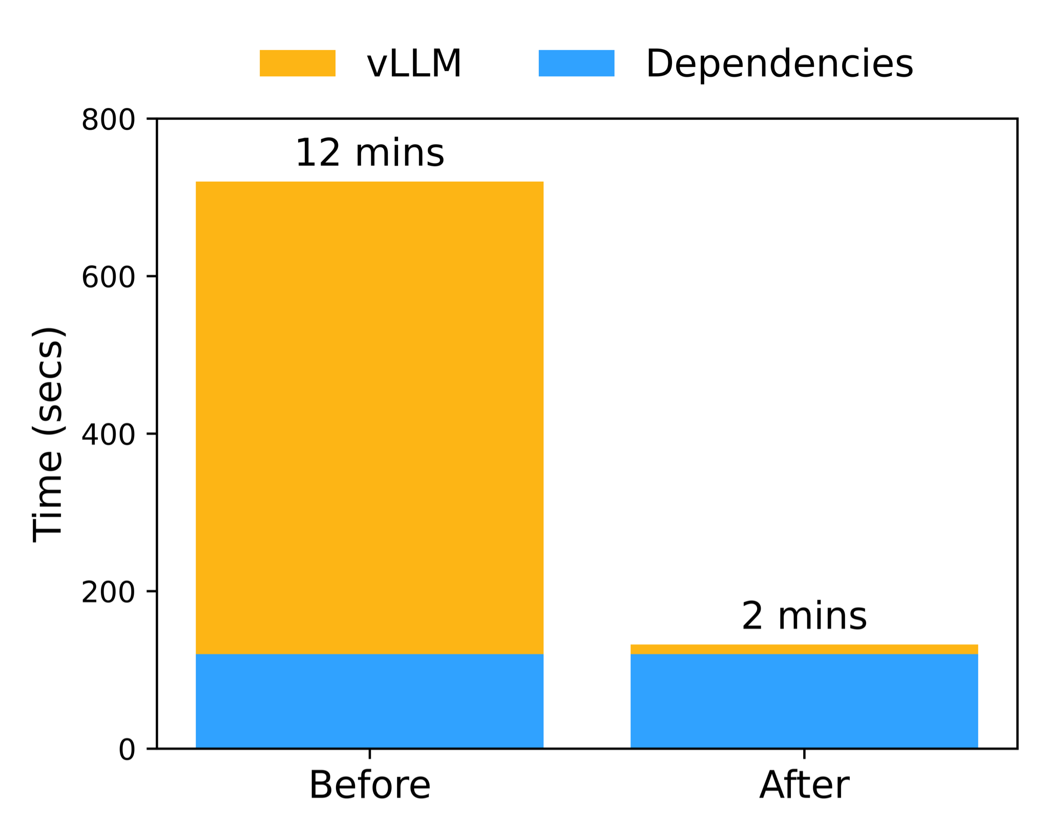
Pre-built CUDA binaries (since v0.1.4)
No need for compilation
Fast installation
12 secs for installing vLLM
2 mins for end-to-end installation

Slide 44



Integration with serving libraries
API Server
OpenLLM
Observability
Model versioning
Autoscaling
. . .
Serving Library
NVIDIA
Triton
Inference Engine

Slide 45
Our journey since the project release
1. Supporting new models
2. Optimizing performance
3. Ensuring correctness & robustness
4. Improving usability
5. Code gardening & refactoring

Slide 46
Maintaining simple and clean code
Goal: Making vLLM easy to understand, hack, and contribute
High standard for code complexity
Refactoring
Scheduler (PR #658, #1251)
Tensor parallelism (PR #1181)
Quantization (PR #926, #1032)
Ray utils (PR #397)
AsyncLLMEngine (PR #880)

Slide 47
vLLM Roadmap
Woosuk Kwon & Zhuohan Li

Slide 48

vLLM will remain open-source
Apache 2.0 License

Slide 49
Future Roadmap (Overview)
Optimizing latency
Better quantization support
CUDA-level optimizations

Slide 50
Optimizing latency (1): Lightweight runtime
Python/PyTorch overhead
CPU
torch.nn.Linear
torch.nn.GELU
torch.nn.Linear
GPU
matmul
kernel
gelu
kernel
matmul
kernel
Idle
Idle
Time
Python/PyTorch overhead takes up to 50% of overall latency

Slide 51



Optimizing latency (1): Lightweight runtime
Lightweight Runtime
CPU
GPU
matmul
kernel
gelu
kernel
matmul
kernel
Time
Two solutions
Runtime

Slide 52
Optimizing latency (2): Multi-process architecture
Single-process architecture
(Current)
Multi-process architecture
Process 1
Request handling
Request handler
Async. send
Process 2
Tokenization
Tokenizer
Async. send
Process 3
Model execution
Model
Executor
Async. send
Process 4
De-tokenization
De-tokenizer
Async. send
Process 5
Token streaming
Token
Streamer

Slide 53
Optimizing latency (3): Speculative decoding
Small model writes a draft → Large model verifies it
Verification
Draft
Several
famous
songs
are
⑤ composed
① Several
② famous
③ songs
④ are
Large Model
(#parameter: 10xN)
Small Model
(#parameter: N)
<s>
Several
famous
songs
<s>
Several
famous
songs
are
Autoregressive (sequential)
Non-autoregressive (parallel)
* Figure adapted from Kim et al., “Speculative Decoding with Big Little Decoder” (NeurIPS 2023)

Slide 54
Better quantization support
Step 1: Develop a general abstraction for diverse quantization methods.
Step 2: Implement diverse quantization methods.
[WIP] GPTQ, SmoothQuant, SqueezeLLM
[TODO] GGML, GGUF, . . .
Step 3: Optimize the performance of quantized ops.

Slide 55
CUDA-level optimization: PagedAttention kernel
PagedAttention takes 20-40% of overall running time
Optimization 1: Better work partitioning
(leveraging sequence-level parallelism)
Optimization 2: Efficient MQA/GQA support

Slide 56
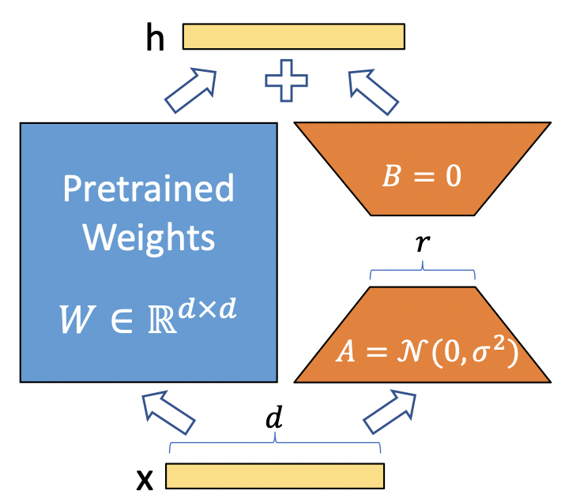

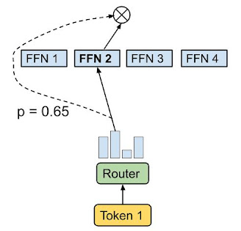
Second-priority items
(Efficient) LoRA support*
AMD GPU support
Stage 1
Stage N
. . .
Mixture-of-Experts
Pipeline parallelism
* Figure adapted from Hu et al., “LoRA: Low-Rank Adaptation of Large Language Models” (ICLR 2022)

Slide 57
Q&A on future roadmap (5 min)
First-Priority Features
Second-Priority Features
Latency optimization
Lightweight runtime
Multi-process architecture
Speculative decoding
Better quantization support
CUDA-level optimization
(Efficient) LoRA support
AMD support
Mixture-of-experts
Pipeline parallelism

Slide 58





vLLM Networking Hour!
https://github.com/vllm-project/vllm
https://vllm.ai
https://arxiv.org/abs/2309.06180
https://discord.gg/jz7wjKhh6g
@woosuk_k
@zhuohan123
Please fill out our survey before you leave:

